Slide 1
Untitled
Paolo Eusebi

Slide 2
Four phases in architecture of diagnostic research
Phase I Do test results in patients with the target disorder differ from those in normal people? Table 1 shows the architecture of this question.
Phase II Are patients with certain test results more likely to have the target disorder than patients with other test results?
Phase III Does the test result distinguish patients with and without the target disorder among patients in whom it is clinically reasonable to suspect that the disease is present?
Phase IV Do patients who undergo this diagnostic test fare better (in their ultimate health outcomes) than similar patients who are not tested?

Slide 3
Measures of diagnostic accuracy
 | D+ | D-
T+ | TP | FP
T- | FN | TN

Slide 4
Measures of diagnostic accuracy
Sensitivity = TP/D+
Specificity = TN/D-
PPV = TP/T+
NPV = TN/T-

Slide 5
Slide with R Output
summary(cars)
## speed dist ## Min. : 4.0 Min. : 2.00 ## 1st Qu.:12.0 1st Qu.: 26.00 ## Median :15.0 Median : 36.00 ## Mean :15.4 Mean : 42.98 ## 3rd Qu.:19.0 3rd Qu.: 56.00 ## Max. :25.0 Max. :120.00

Slide 6
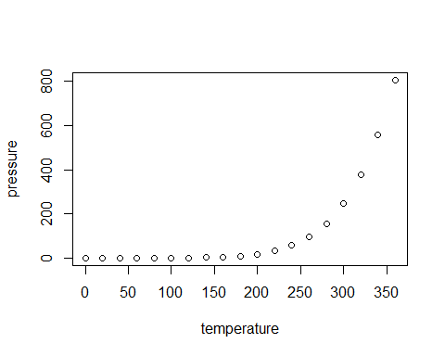
Slide with Plot

